Slide 1

Vehicle Insurance System
A Web-Based Modernization of Automobile Insurance
Problem statement:
Imagine you are working for an insurance company that wants to modernize
its operations by developing a comprehensive Insurance Management
System for automobiles. The goal is to create a web-based application that
allows users to manage policies, claims, and customer information efficiently.
Presented by: Sourabh Vishwakarma

Slide 2

Project Objective:
To design and develop a secure, efficient, and user-friendly web-based
application that automates and streamlines theend-to-end process of
vehicle insurance management.
This includes enabling users to submit policy proposals, receive quotes, make premium
payments, download policy documents, and track their insurance status—while providing
insurance officers with tools to review, approve, and manage proposals, documents,
and policies—all within a secure, scalable, and responsive digital environment.
Develop a RESTful backend system to manage vehicle insurance operations
Implement modular, layered architecture using Java Spring Boot
Build a responsive frontend interface using Angular
Ensure secure user access with JWT-based authentication and role-based control
Use MySQL for efficient and scalable data storage
Provide interactive API documentation and testing via Swagger UI
Enable policy proposal, quote generation, premium payment, and policy tracking
Design system to support future enhancements like claim processing and cloud deployment
=

Slide 3
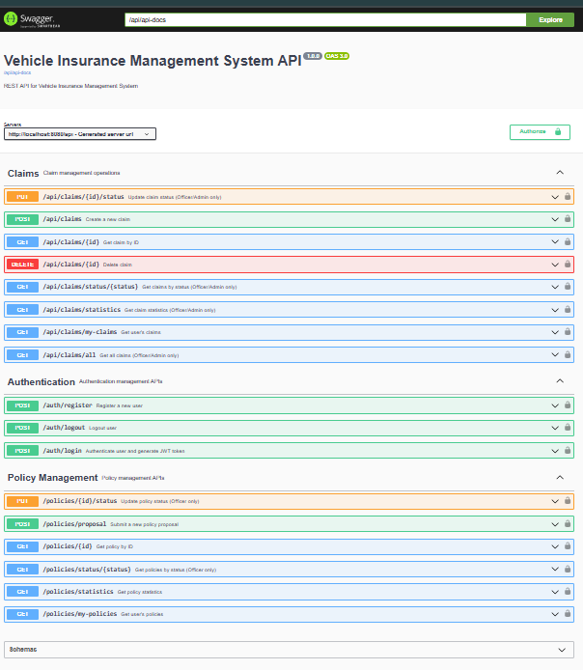
Technology Stack
Programming Language: Java 17
Backend Framework: Spring Boot
ORM: Spring Data JPA (Hibernate)
Database: MySQL
Build Tool: Maven
Authentication: JSON Web Token (JWT)
API Testing & Documentation: Swagger UI, Postman
Frontend Framework: Angular

Slide 4
Key Actors and Their Interactions
System Actors
User Use Cases
User: The policyholder or applicant.
Register & Login
Insurance Officer: Manages proposals and policies.
Submit Proposal
System: Handles authentication and automated notifications.
Make Premium Payment
Track Policy Status
Download Policy
Officer Use Cases
System Use Cases
Login
Secure JWT-based authentication
Review Proposals
Automated email notifications
Request Additional Info
Data validation and integrity checks
Approve/Reject Proposal
Generate Quote
Activate Policy

Slide 5
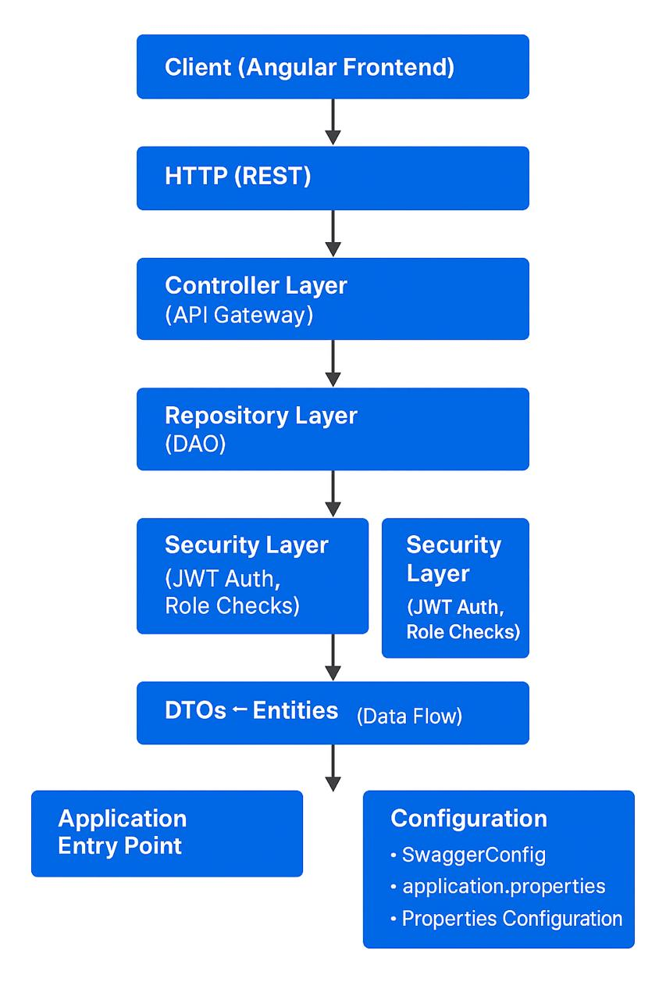
backend/
│
├── 📄 pom.xml # Maven configuration file
├── 📄 mvnw.cmd # Maven wrapper script (Windows)
│
├── 📁 .mvn/ # Maven wrapper configuration
│ └── wrapper/
│ └── maven-wrapper.properties
│
├── 📁 src/ # Source code directory
│ ├── 📁 main/ # Main application code
│ │ ├── 📁 java/ # Java source files
│ │ │ └── com/vehicleinsurance/ # Base package
│ │ │ │
│ │ │ ├── 📄 VehicleInsuranceApplication.java # Main Spring Boot class
│ │ │ │
│ │ │ ├── 📁 config/ # Configuration classes
│ │ │ │ └── SwaggerConfig.java
│ │ │ │
│ │ │ ├── 📁 controller/ # REST API controllers
│ │ │ │ ├── AuthController.java
│ │ │ │ ├── ClaimController.java
│ │ │ │ └── PolicyController.java
│ │ │ │
│ │ │ ├── 📁 dto/ # Data Transfer Objects
│ │ │ │ ├── ClaimDto.java
│ │ │ │ ├── LoginDto.java
│ │ │ │ ├── PolicyProposalDto.java
│ │ │ │ └── UserRegistrationDto.java
│ │ │ │
│ │ │ ├── 📁 entity/ # JPA Entity classes
│ │ │ │ ├── Claim.java
│ │ │ │ ├── ClaimStatus.java
│ │ │ │ ├── CoverageType.java
│ │ │ │ ├── Policy.java
│ │ │ │ ├── PolicyStatus.java
│ │ │ │ ├── Role.java
│ │ │ │ ├── User.java
│ │ │ │ └── VehicleType.java
│ │ │ │
│ │ │ ├── 📁 repository/ # JPA Repository interfaces
│ │ │ │ ├── ClaimRepository.java
│ │ │ │ ├── PolicyRepository.java
│ │ │ │ └── UserRepository.java
│ │ │ │
│ │ │ ├── 📁 security/ # Security configuration
│ │ │ │ ├── AuthEntryPointJwt.java
│ │ │ │ ├── AuthTokenFilter.java
│ │ │ │ ├── JwtUtils.java
│ │ │ │ ├── UserDetailsServiceImpl.java
│ │ │ │ └── WebSecurityConfig.java
│ │ │ │
│ │ │ └── 📁 service/ # Business logic services
│ │ │ ├── ClaimService.java
│ │ │ ├── PolicyService.java
│ │ │ ├── PremiumCalculationService.java
│ │ │ └── UserService.java
│ │ │
│ │ └── 📁 resources/ # Application resources
│ │ └── application.properties # Spring Boot configuration
│ │
│ └── 📁 test/ # Test source files
│ └── java/
│ └── com/vehicleinsurance/ # Test classes mirror structure
│
└── 📁 target/ # Build output directory (generated)
├── 📄 vehicle-insurance-backend-1.0.0.jar # Executable JAR file
├── 📁 classes/ # Compiled Java classes
├── 📁 generated-sources/ # Generated source files
├── 📁 maven-archiver/ # Maven build metadata
├── 📁 maven-status/ # Maven compilation status
└── 📁 test-classes/ # Compiled test classes
Backend
Folder
Structure
System
Architecture

Slide 6
Core Functional Modules
Authentication: Secure login for users and officers via JWT.
Document Handling: Upload and download PDF policy documents easily.
Proposal Management: Create, update, and track insurance proposals.
Policy Lifecycle: Track status changes and automate expiry reminders.
Quote Generation: Dynamic premium calculation based on vehicle details and add-ons.
Email Notifications: Automated alerts for quotes, payments, and policy expiry.

Slide 7
Authentication & Authorization (Planned)
✅ Open APIs currently enabled for demo and testing.
JWT-based login/signup structure implemented
👥 Role-Based Access Control (RBAC) planned with the following roles:
CUSTOMER – Can submit proposals, make payments, track policies
EMPLOYEE – Can review proposals, approve/reject, request documents
ADMIN – Full access to manage users, policies, and roles
🛡️ Access control hooks in place using Spring Security annotations (@PreAuthorize, @Secured)
🚀 Easily extendable to secure all endpoints when moved to production

Slide 8

Testing & Documentation
🧪 Unit & Integration Testing
Frameworks used: JUnit and Spring Boot Test
Focused on service and controller layers for business logic and API flow validation
📘 API Testing & Documentation
Swagger UI for live API documentation and testing
Postman used for manual testing and collection sharing
🧾 Structured JSON Error Responses
Custom global exception handling
User-readable messages with HTTP status codes

Slide 9
✅ Features Summary
✔️ RESTful APIs for seamless frontend-backend communication
✔️ Layered Architecture with clear separation of concerns
✔️ DTO-Based Design to ensure clean data exchange
✔️ Swagger UI Integration for interactive API documentation
✔️ Modular Codebase following best practices for scalability
✔️ Relational Database (MySQL) with proper entity relationships
✔️ Open for Testing, structured for future security upgrades (JWT, RBAC)

Slide 10
🚀 Future Enhancements
🔐 Enable JWT Login & Registration APIs Implement secure authentication and role-based access control
⚙️ Integrate CI/CD Pipeline using GitHub Actions Automate build, test, and deployment workflows
📦 Containerize with Docker Package backend and frontend for scalable deployment
🧑‍💼 Add Admin Dashboards & Frontend Integration Expand UI with role-specific views and functionalities
📊 Advanced Reporting Module with Charts Visualize key metrics like policy counts, claim ratios, and premium totals

Slide 11
Thank you
Github- https://github.com/plasma84/AutomobileInsuranceSystem.git
vsourabh251@gmail.com

